Slide 1
DS551/CS525 2023 Fall
Project 3 - Deep Q-learning
10/6/2023

Slide 2
Outline
Introduction
Game Playing : Breakout
Deep Reinforcement Learning
Deep Q-Learning (DQN)
Improvements to DQN
Grading & Format
Grading Policy
Code Format
Submission
WPI Turing or Google Cloud Platform & Pytorch Tutorial

Slide 3
Environment
Introduction
Breakout
Get average reward >= 40 in 100 episodes (5 lives per episode)
In testing, we consider each episode with its all 5 lives
With OpenAI’s Atari wrapper (modified by us a little bit)

Slide 4
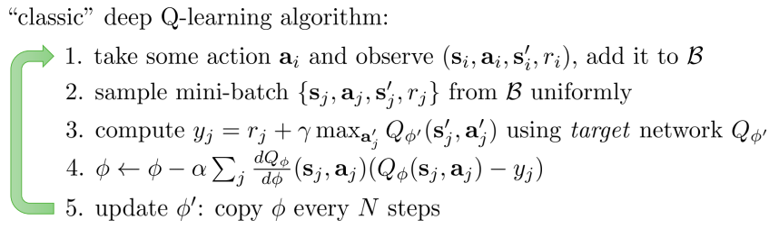
Deep Q-Learning (DQN)
Deep Reinforcement Learning
Replay buffer
Fixed targe-Q

Slide 5
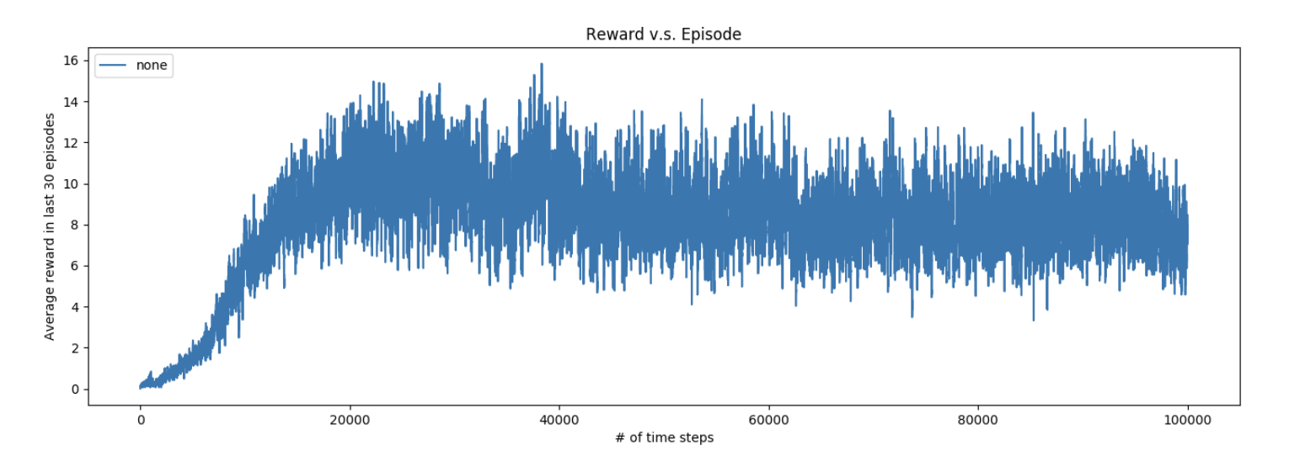
Training Plot
Introduction
Training curve
Average score in the last 30 lives
X-axis : number of training steps
Y-axis : average reward in every 30 lives (not 30 complete episodes).
Notes:
Need to be replaced

Slide 6
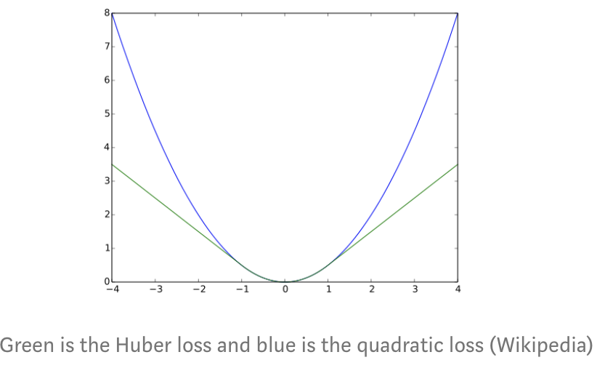
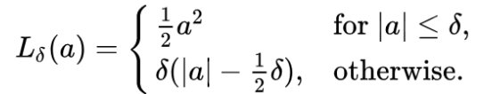
Deep Q-Learning (DQN)
Deep Reinforcement Learning
The action should act ε-greedily
Random action with probability ε
Linearly decay ε from 1.0 to some small value, say 0.025
Decay per step:(epsilon - epsilon_min) /number of epsilon step
Hyperparameters (just suggestion)
Replay Buffer Memory Size 10,000 (deque)
Start to train DQN with buffer size 5000
Update Target Network every 5000 steps
Learning Rate 1.5e-4, Batch Size 32
Adam optimizer
Huber Loss (F.smooth_l1_loss)
Clip gradients between (-1,1)
Notes:
-Huber loss allows less dramatic changes which often hurt RL.

Slide 7
Improvements to DQN
Deep Reinforcement Learning
Double Q-Learning
Dueling Network
Prioritized Replay Memory
Noisy DQN
Distributional DQN
https://arxiv.org/pdf/1710.02298.pdf

Slide 8
Other Training Tips
Deep Reinforcement Learning
How to use Pytorch
Official DQN Pytorch Tutorial
DQN Tutorial on Medium
Official DQN paper
See more tips on project website
https://github.com/lllyyyt123/WPI-DS551-Fall23/blob/main/Project3/README.md

Slide 9
Grading Policy
Grading & Format
Python code (20 points)
Trained Model (50 points)
Get averaging reward >= 40 in 100 episodes (each of 5 lives) in Breakout
With OpenAI’s Atari wrapper
PDF Report (30 points)
Describe your DQN model
Screenshot of the average score in 100 episodes
Plot the training curve (training steps can defined by yourself)
X-axis: number of training steps
Y-axis: average reward in last 30 lives

Slide 10
Code Format
Grading & Format
Please download all the .py files from github
Follow the instructions in README to install packages
Six functions you should implement in agent_dqn.py
__init__(self, env, args)
init_game_setting(self)
make_action(self, state, test)
train(self)
push(self)
repaly_buffer(self)
DO NOT add any parameter in __init__(), init_game_setting() and make_action()
You can change the seed
You can add new functions in the agent_dqn.py

Slide 11
Code Format
Grading & Format
Two functions you should implement in dqn_model.py
__init__(self)
forward(self, x)
You can add parameters in these two functions
You can add new functions in the dqn_model.py
You can add your arguments in argument.py (if needed)
Please don’t revise test.py, main.py, environment.py, atari_wrapper.py and agent.py

Slide 12
Deliverables
Grading & Format
Deadline: Week 10, Tuesday Dec 31, 2022 (23:59)
Your submission MUST have following files
agent_dqn.py, dqn_model.py, argument.py
[saved_model_file] (.pth file)
report.pdf
README (with details of what files you have modified.)
other files you need
If your model is too large for canvas, upload it to a cloud space (like dropbox, google drive) and provide the link to download the model

Slide 13
Package
Grading & Format
Please use Python3
The TA will execute ‘python main.py --test_dqn’ to run your code on ubuntu+GPU
The execution for the model should be done within 20 minutes, excluding model download
Allowed packages
PyTorch
Numpy
Scipy
Pandas
Python Standard Lib
etc.

Slide 14
Setup
Recommended programming IDE (integrated development environment): VS code (See install VS code)
Install Miniconda
Install Python 3, by default, it's Python 3.11.4 now (Aug 20, 2023).
Create virtual environment: conda create -n myenv python
Activate your virtual environment: conda activate myenv
Install gymnasium: pip install opencv-python-headless gymnasium[atari] autorom[accept-rom-license] (See install gymnasium)
install pytorch: See install pytorch
For the Atari wrapper, install the following two items: pip install -U "ray[rllib]" ipywidgets
For video recording in testing, install the following three items: conda install -c conda-forge moviepy, conda install -c conda-forge ffmpeg, conda update ffmpeg
When testing, for nice output on the terminal, you need to install tqdm: conda install -c conda-forge tqdm
The links above are available on project 3 github page.

Slide 15
Environment Preparation
GPU resources:
1. How to use WPI Turing GPUs with your WPI account
2. Google Cloud https://cloud.google.com/gpu
See more details in the next slide

Slide 16
backup

